Slide 1
Эффективность внедрения современных приемов на уроках на примере использования приложения Quizlet
Серякова Надежда Викторовна
МАОУ СОШ № 54
г. Томск

Slide 2
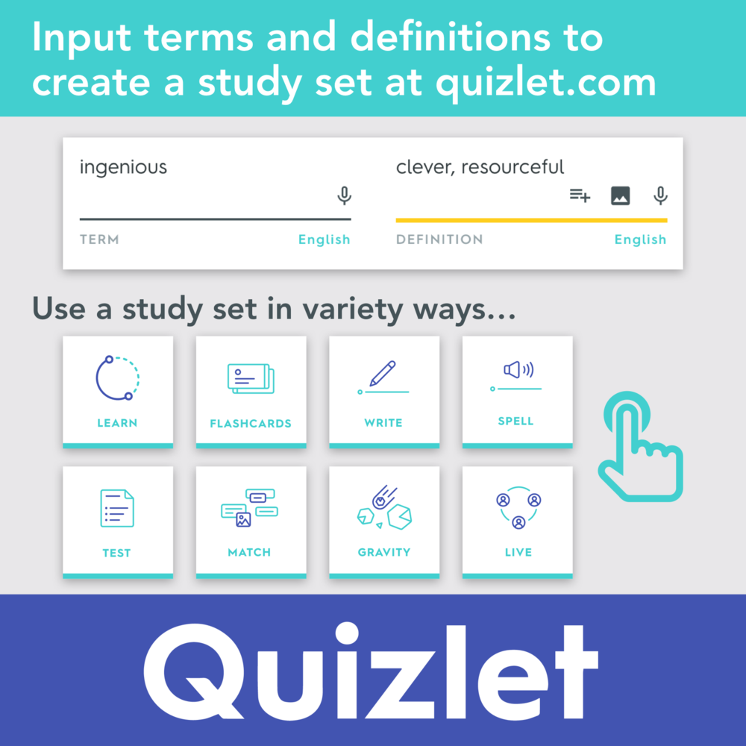
Contents
1
Add your text in here
2
Add your text in here
3
Add your text in here
4
Add your text in here
5
Add your text in here

Slide 3
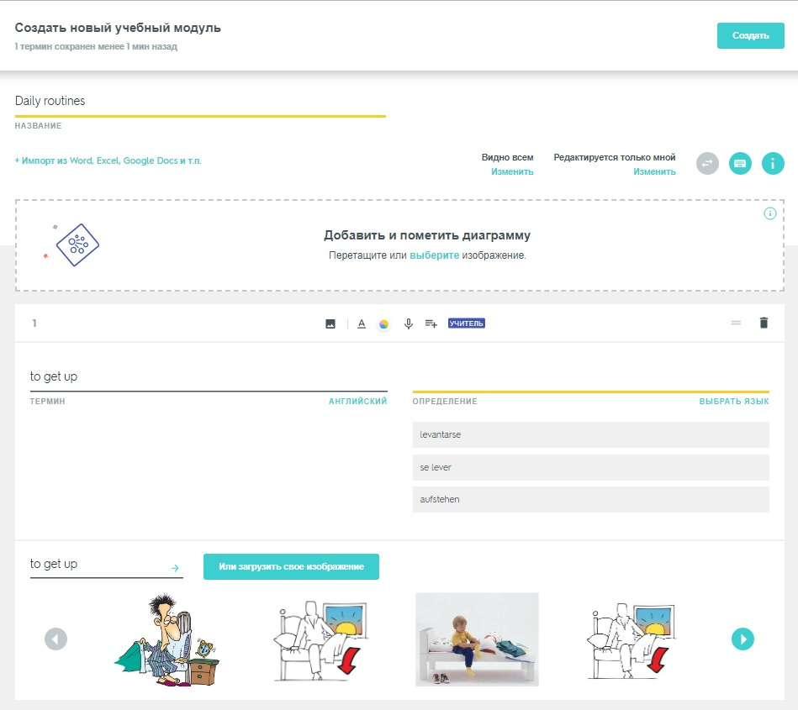
Создание модуля

Slide 4
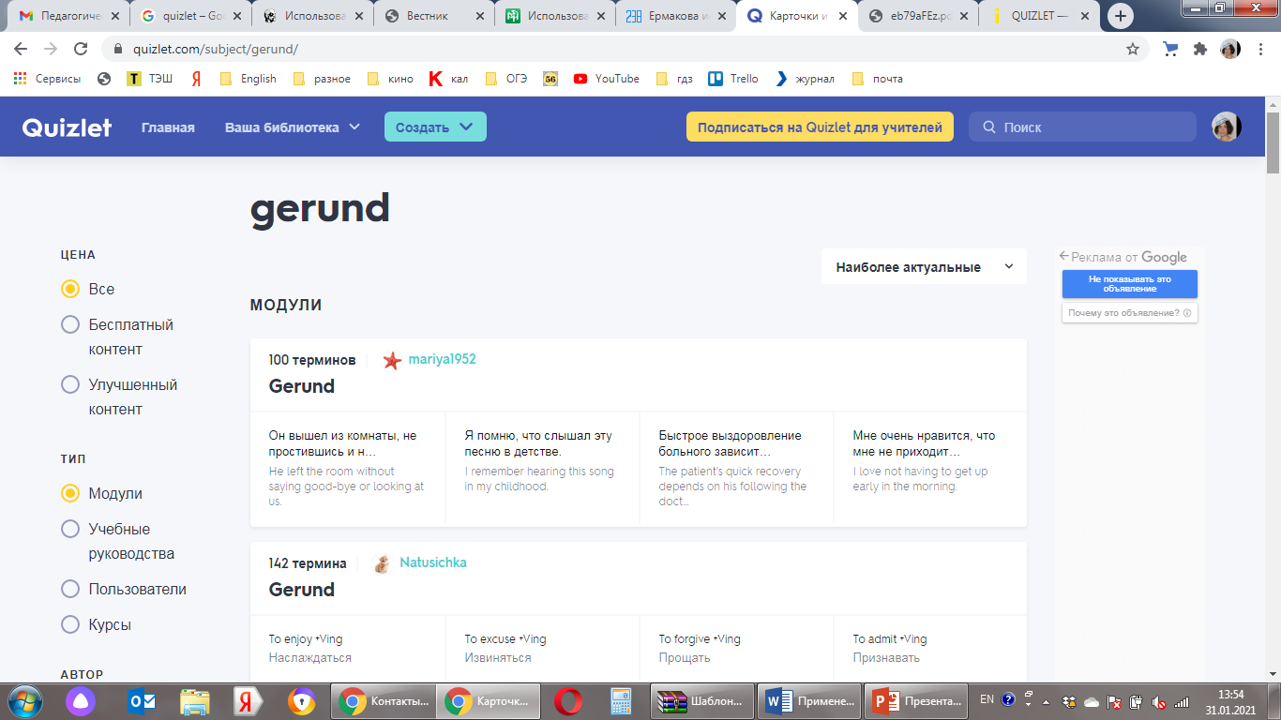
Готовые шаблоны
How do I incorporate my logo and URL to a slide that will apply to all the other slides?
  On the [View] menu, point to [Master], and then click
  [Slide Master] or [Notes Master]. Change images to the one you like, then it will apply to all the other slides.
[ Image information in product ]
Image : www.opanas.com, CD : 01_School life(PhotoDisc)
Note to customers : This image has been licensed to be used within this PowerPoint template only.
You may not extract the image for any other use.

Slide 5

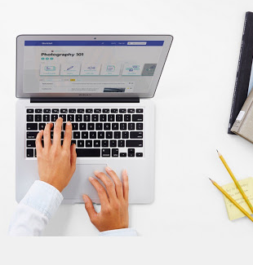
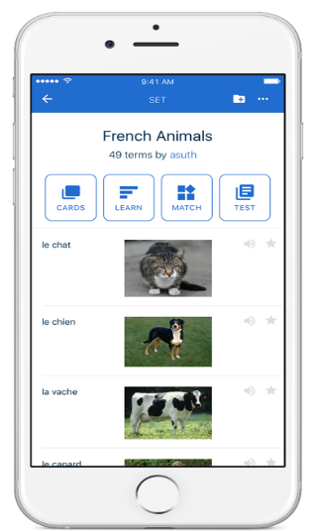
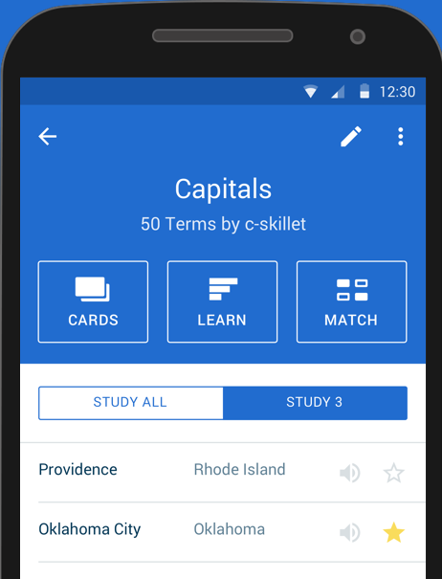
ПК
IOS
Android
ThemeGallery is a Design Digital Content & Contents mall developed by Guild Design Inc.
Description of the contents
Description of the contents

Slide 6
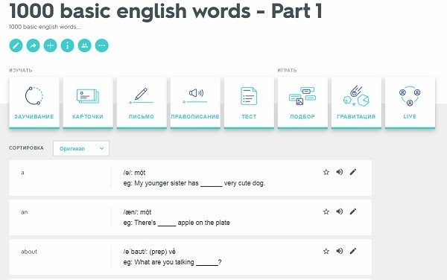




Режимы Quizlet
1. Description of the business
Text
4. Description of the business
Text
Text
5. Description of the business
2. Description of the business
Text
3. Description of the business
ThemeGallery is a Design Digital Content & Contents mall developed by Guild Design Inc.
Text

Slide 7
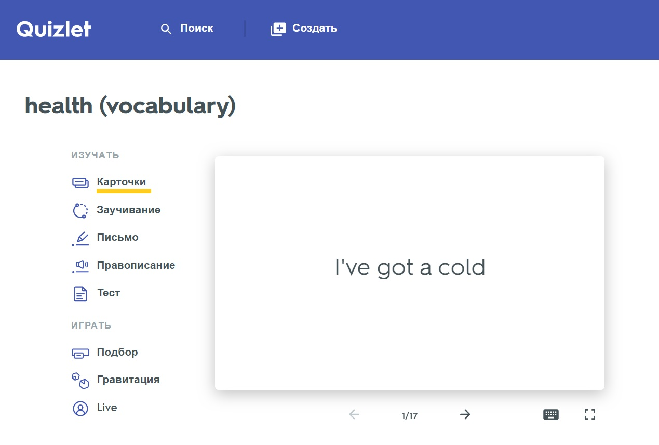
Режим карточек
Text in here
Title in here
Please write down of contents.
Text in here
ThemeGallery is a Design Digital Content & Contents mall developed by Guild Design Inc.

Slide 8
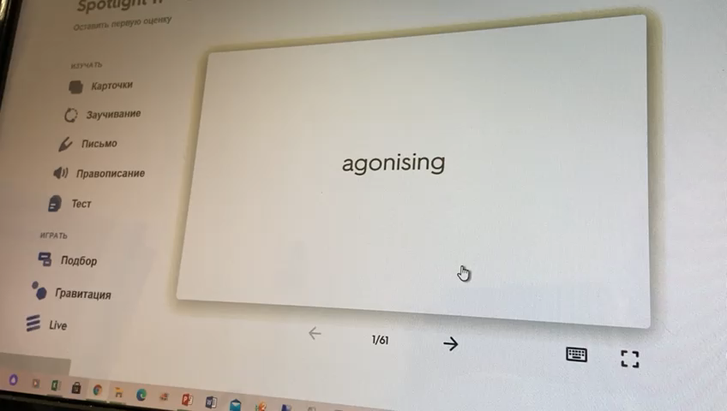
Режим карточки

Slide 9
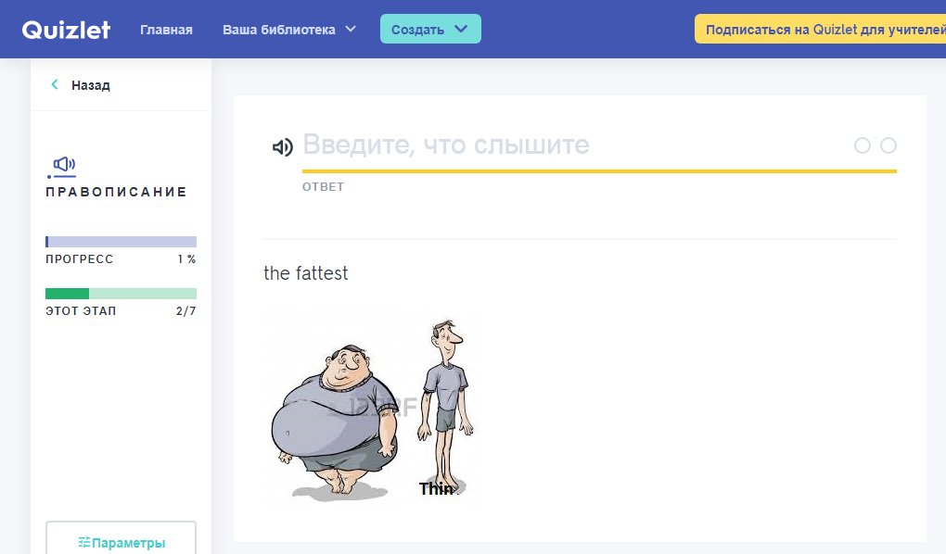
Режим правописания
ThemeGallery is a Design Digital Content & Contents mall developed by Guild Design Inc.
Title
Title
text in here
1. Describe contents for a Chart
Description of the company’s sub contents
Description of the company’s sub contents
Title
text in here
Title
text in here
text in here
2. Describe contents for a Chart
Description of the company’s sub contents
Description of the company’s sub contents
Chart Title in here

Slide 10
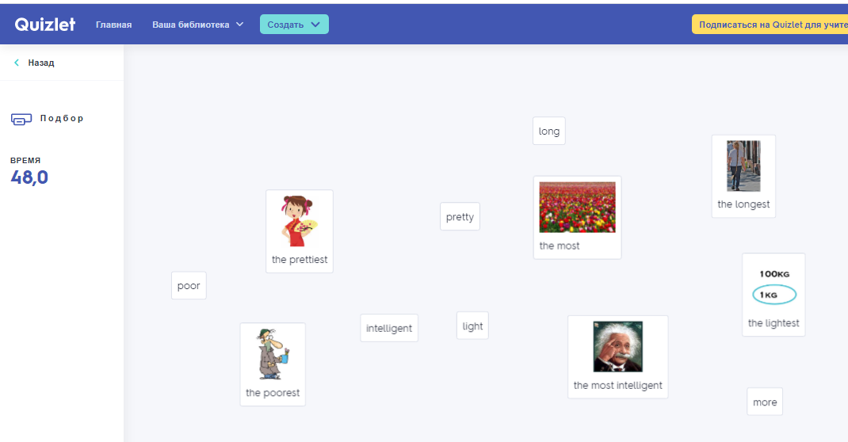
Режим подбора

Slide 11
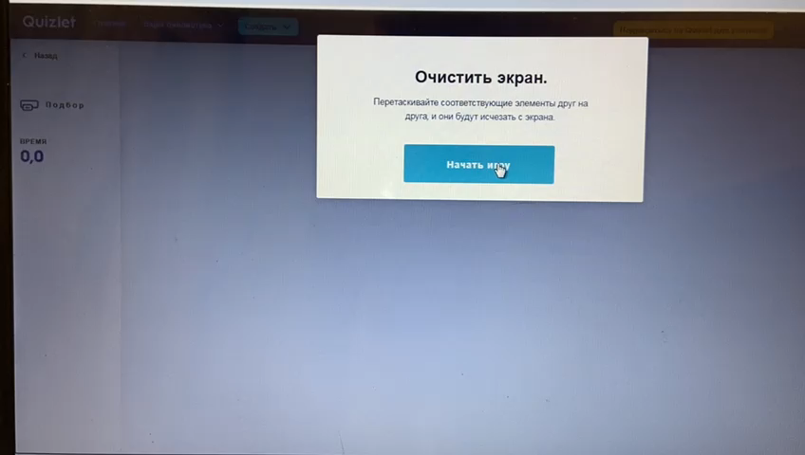
Режим подбора

Slide 12
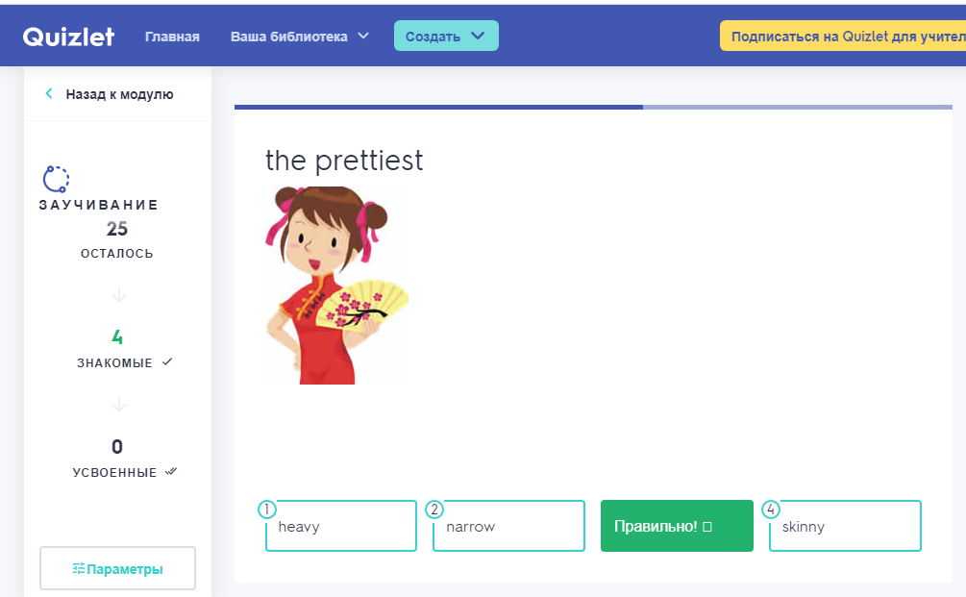
Режим заучивания
ThemeGallery is a Design Digital Content & Contents mall developed by Guild Design Inc.
Title in here
ThemeGallery is a Design Digital Content & Contents mall developed by Guild Design Inc.
Title in here
ThemeGallery is a Design Digital Content & Contents mall developed by Guild Design Inc.
Description of the contents
Title in here
ThemeGallery is a Design Digital Content & Contents mall developed by Guild Design Inc.
Title in here
ThemeGallery is a Design Digital Content & Contents mall developed by Guild Design Inc.

Slide 13
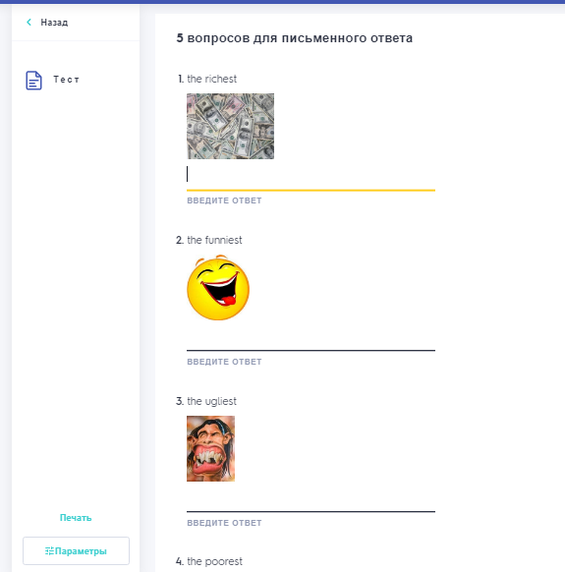
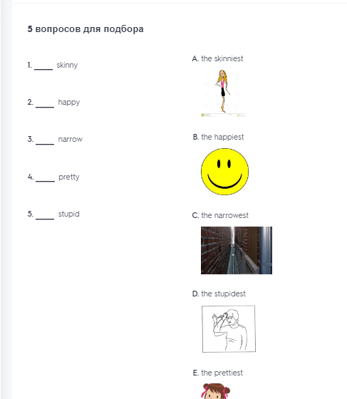
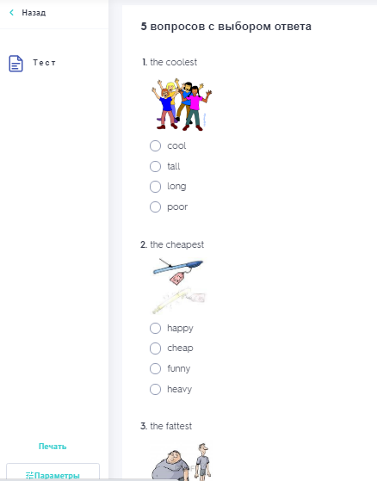
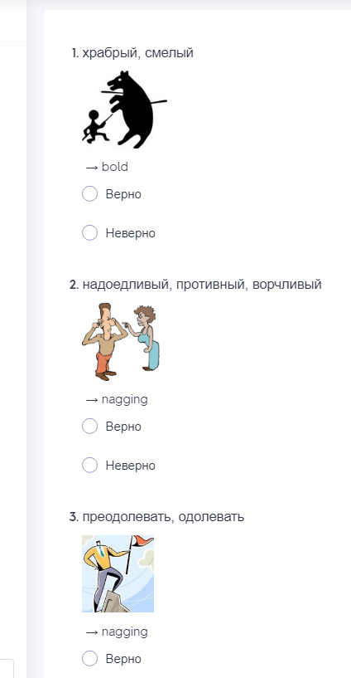
Режим тестирования
Письменные вопросы
В виде подбора
С множественным выбором
Contents01
18.5%
Верно-неверно
Contents02
17.5%
Contents03
8.7%
Contents04
23.6%
63.6%
84.3%

Slide 14
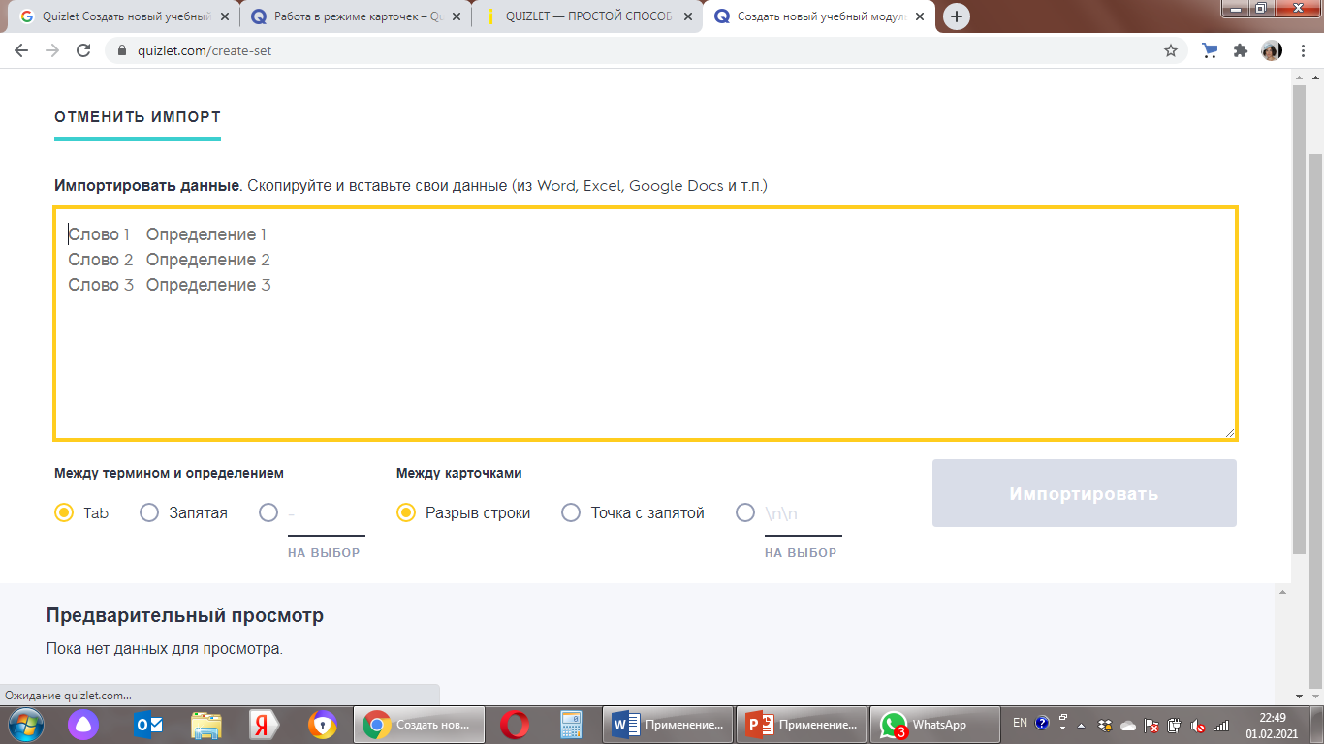
Достоинства

Slide 15
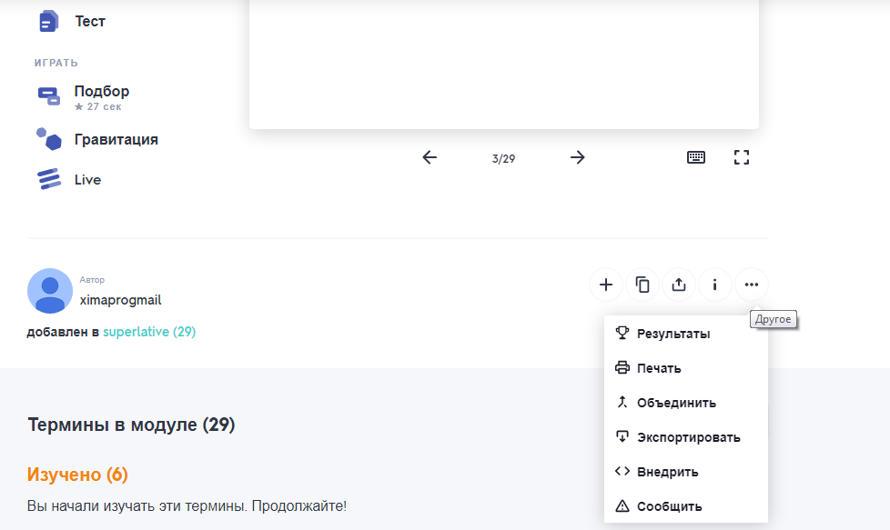
Достоинства
Добавить модуль в курс
или папку
Опубликовать
Копировать

Slide 16


Slide 17
Thank you!
NVS1006@gmail.com

Slide 18
Литература
1.Отзыв пользователя Valuer. QUIZLET - Незаменимое пособие для репетитора и самообучающихся
//http://irecommend.ru/content/quizlet-nezamenimoe-posobie-dlya-repetitora-i-samoobuchayushchikhsya-repetitor-vy-ili-ucheni
2. May Kim. Достоинства программы Quizlet c точки зрения преподавателя и студента.
//http://www.temauroka.ru/multimedia/testirovanie-yazykovogo-materiala-v-p.html
3.Симакова В. Quizlet — простой способ выучить новое
//https://uip.me/2013/07/quizlet-prostoj-sposob-vyuchit-novoe-obzor/
4. Заславская О.Ю. Создание онлайн-карточек и заданий разного типа Quizlet.com //http://pedsovet.su/publ/164-1-0-4418

